Slide 1
Pub Quiz: The English Edition

Slide 2
Part One
The Basics

Slide 3
1. As widespread as English is, it’s not the most spoken language in the world. There are two languages with more speakers than English. One is spoken by 400 million and the other by the amazing 1.2 billion speakers. Name the two languages!

Slide 4
2. There are three nicknames for the US flag: The Stars and Stripes, Old Glory and ______________________.

Slide 5
3. What is the name of the UK anthem?

Slide 6
4. What is Big Ben?

Slide 7
5. How many states are there in the USA?

Slide 8
6. True or false?
New York is the capital of the State of New York.

Slide 9
7. Match the animals and parts of UK!
England 1) none
Scotland 2) lion
Wales 3) unicorn
Northern Ireland 4) red dragon

Slide 10
8. What kind of a party took place in Boston in 1773?
coffee
tea
slumber
birthday

Slide 11
9. Today it’s the dreamland of many, but between 1788 and 1868 this country served as a prison of the British Empire. Which country is it?

Slide 12
10. Which of these expressions wasn’t invented in an English speaking country?
party breaker
party pooper
party animal
party crasher

Slide 13
Part Two
Girl Power

Slide 14
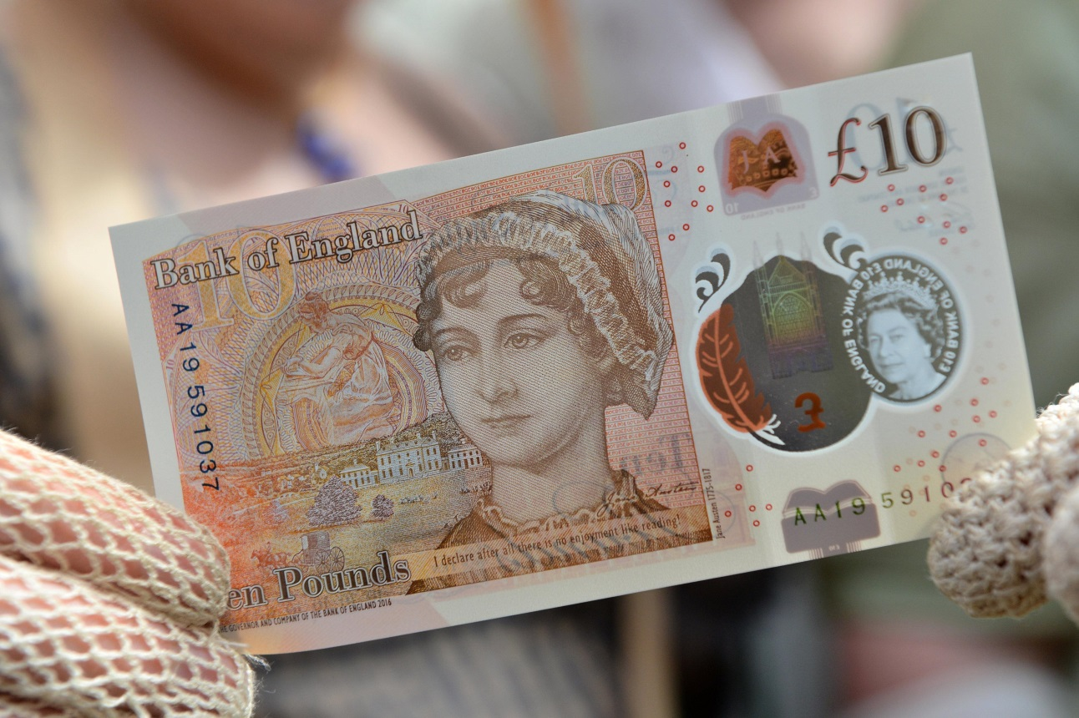
1. Who is the only other woman, apart from the Queen, featured on British banknotes?

Slide 15
2. Which of these is an actual nickname for a Spice Girl?
salt
pepper
ginger
sugar

Slide 16
3. Who is the first female author to earn a billion $?

Slide 17
4. The UK had two female Prime Ministers. What are their surnames?
Thatcher and May
Major and June
Cameron and Wilson
House and Home

Slide 18
5. How many Queens have ruled over Great Britain?
a) 2
b) 3
c) 4
d) 5

Slide 19
6. Harry Potter’s smartest friend is called…

Slide 20
7. While on holidays in Switzerland in 1816, a teenage girl called Mary Shelley thought of a story about a doctor called Victor. In the story, the doctor creates a monster and the monster kills him. In real life, it has become one of the most famous monsters in the history of film and literature. The doctor’s surname became it’s name.
Name the monster!

Slide 21
8. Beyonce was born in…
a) Denver, Colorado
b) Honolulu, Hawaii
c) Salem, Oregon
d) Houston, Texas

Slide 22
9. She is one of the most powerful women in the world. She started as a talk show host, but now she owns her own TV network called „OWN”, a magazine called „O”, a film studio called „HARPO” and a radio channel.
Her name is simply…

Slide 23
10. What’s the name of Peter Pan’s fairy?
a) Ariel
b) Bella
c) Tinker Bell
d) Rapunzel

Slide 24
Part Three
River City

Slide 25
1. „Bard” is a pub in Rijeka, but also a nickname for one of the most famous writers in history of world literature. He invented as many as 1700 English words. What is his name?

Slide 26
2. Some of the passengers from the Titanic were rescued by a ship called Carpathia. It wasn’t there by accident. At the beginning of the 20th century, Rijeka was one of the main ports used by people to leave Europe in search of a better life. Carpathia was just one of the ships regularly sailing from Rijeka to ______________. (fill in the gap)

Slide 27
3. A waiter, called Josip Car, was one of the 70 Croatian crew members on Carpathia that evening in 1912. He kept a souvenir from Titanic which can now be found in Rijeka’s Maritime and History Museum. Today, this souvenir is the only one of its kind left in Europe. What is the souvenir?

Slide 28
4. In 1906 the number of people leaving Europe through Rijeka almost reached the number of people living in it. So how many people lived in Rijeka in 1906?
about 150 000
about 100 000
about 75 000
about 50 000

Slide 29
5. Which Irish town is going to be the European Capital of Culture alongside Rijeka in 2020?

Slide 30
6. What is the surname of the famous British engineer who developed the torpedo and opened a torpedo factory in Rijeka at the beginning of the 20th century?

Slide 31
7. One of Rijeka’s museums has got an English name. Name the museum!

Slide 32
8. One of the biggest New York airports, a street and a pub in Rijeka are named after one of the most famous New York mayors . What was his name?

Slide 33
9. One of these sentences is a ridiculous lie. Guess which one!
Voldemort visited Rijeka last summer. He was directing a film about a ballet dancer.
Ernesto Che Guevara visited Rijeka in 1959.
Teatro Fenice was opened by Giacomo Puccini in 1914. He really loved cinemas.
In 1971, the space capsule of Apollo 12 was on display in front of the Governor’s Palace. 30 000 people saw it.

Slide 34
10. Rijeka’s football team outplayed The New Saints of Oswestry Town & Llansantffraid Football Club in July 2017. Which league do The New Saints play in?

Slide 35
Part Four
Time and space

Slide 36
When was the first story about Sherlock Holmes published?
200 years ago
175 years ago
150 years ago
125 years ago

Slide 37
2. Who were the most famous citizens of Liverpool in the 1960s?
The Who
The Beatles
Rolling Stones
Atomic Kitten

Slide 38
3. Legends say that the evil Sheriff of Nottingham was the arch enemy of a famous fighter for justice. There is no statue of the Sheriff in Nottingham, but you can find the hero’s right next to the Nottingham castle.
Name the hero!

Slide 39
4. Who of these people hadn’t lived in the White House before Donald Trump became the President of the USA?
Hillary Clinton
Bill Clinton
Michelle Obama
Ivanka Trump

Slide 40
5. ______________ is the only city in the world which has hosted the Summer Olympic Games 3 times.

Slide 41
6. Which sport wasn’t invented in the UK?
cricket
rugby
football
basketball

Slide 42
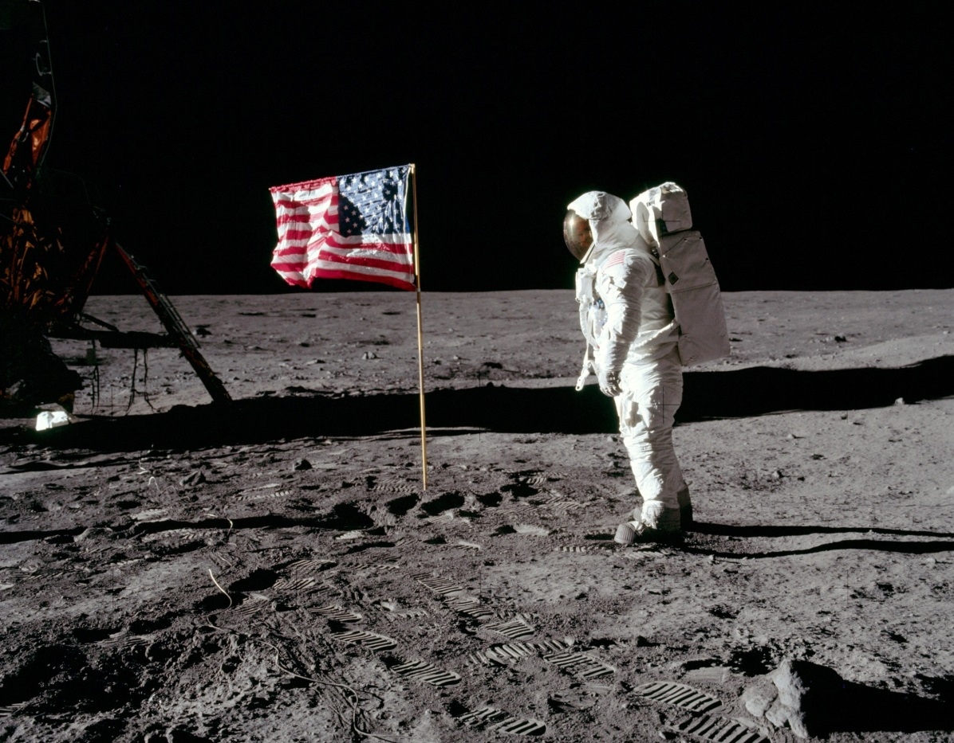
7. When did mankind land on the Moon for the first time? (year)

Slide 43
8. What’s the popular name for the UK leaving the EU?

Slide 44
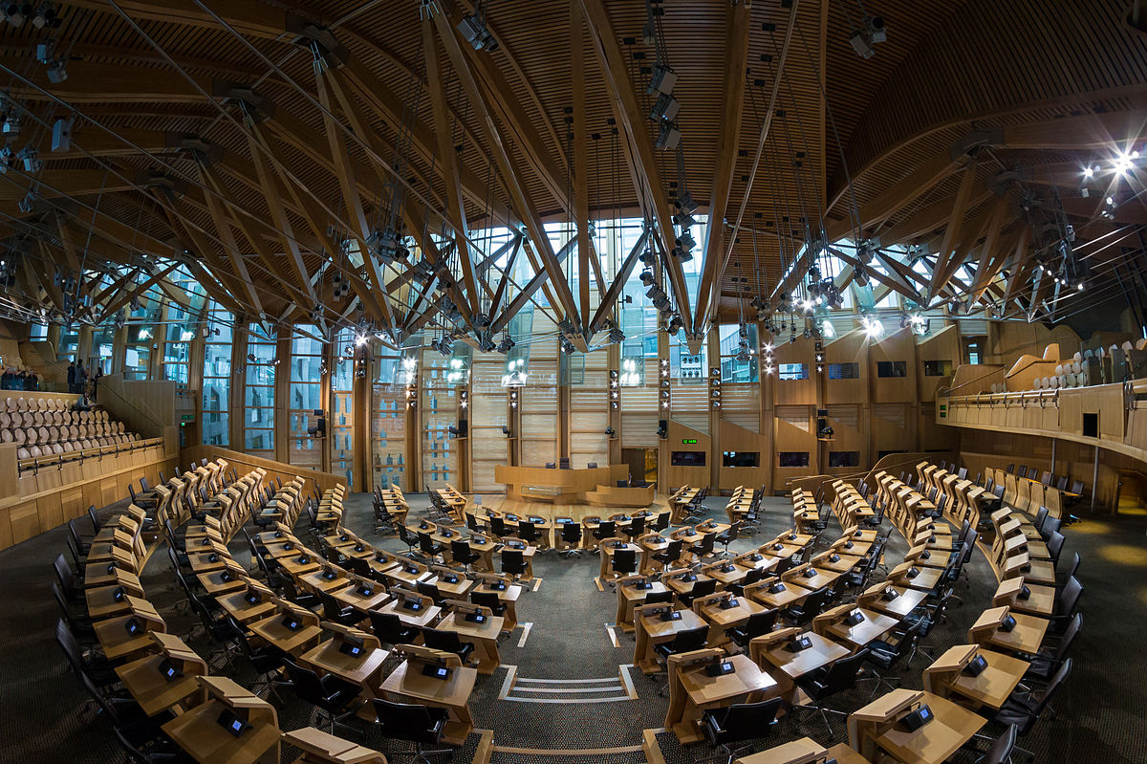
9. Where do you have to go if you want to visit the Scottish Parliament?
Glastonbury
Edinburgh
Glasgow
Aberdeen

Slide 45
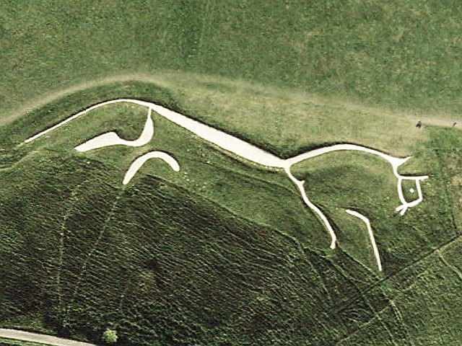
10. This part of the UK is famous for hill figures cut in grass. The most famous are: the Cerne Abbas Giant, the Uffington White Horse and the Long Man of Wilmington. Is it:
Scotland
Wales
England
Northern Ireland

Slide 46
Part Five
Bees, names and nicknames

Slide 47
1. You should write down what your host tells you. But mind the spelling!

Slide 48
2. An Australian animal and an egg-sized fruit share a name. The fruit is brown and hairy on the outside. The same word is also the nickname for New Zealanders. What is it?

Slide 49
3. The Scottish Play is another name for one of the Shakespeare’s tragedies. According to a superstition saying the real name inside a theatre and during the production and rehearsal brings very bad luck.
What is the name that must not be pronounced?

Slide 50
4. Batman’s real name is Bruce Wayne. He is a playboy millionaire living in the city of Gotham.
Which real city has carried that name since 1807?
New York
Detroit
Seattle
Miami

Slide 51
5. Let’s try it once more! You should write down what your host tells you. But mind the spelling!

Slide 52
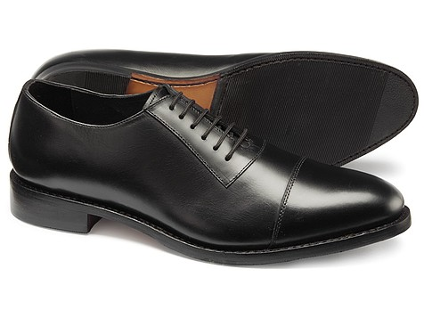
6. Which university were these shoes named after?
Cambridge
Harvard
Oxford
Yale

Slide 53
7. And again! You should write down what your host tells you. But mind the spelling!

Slide 54
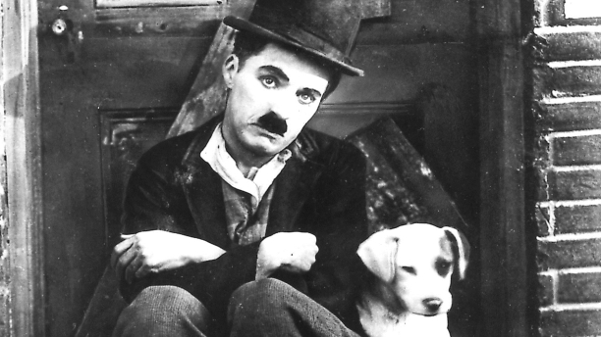
8. He was known as the Tramp, the Kid and the Great Dictator. He was an English comic actor, filmmaker, and composer who rose to fame in the era of silent film.
His name is ________________.

Slide 55
9.
What's in a name? That which we call a rose
By any other name would smell as sweet.
…said Juliet. But where was she when she said it?

Slide 56
10. And you thought it was over. You should write down what your host tells you. But mind the spelling! You can do it!

Slide 57
ALMOST THERE.
If you want to be a champ, there’s one more thing you have to answer.
We are the champions is one of the most iconic songs of the 20 century. Name the band who played it and for an extra point name the lead singer.

Slide 58
Thank you for playing!

