Slide 1
Creative methodology:
games, ideas, techniques and web tools
ŽSV OŠ – Istarska županija
Anita Jokić, prof.
Prva riječka hrvatska gimnazija
Studeni 2017

Slide 2

Creativity? Not again

Slide 3

How to Motivate Students:
Top 12 Ways
If there is one thing we know about our students, it’s that they have short attention spans and prefer to do things later.
This is especially true at the beginning of the year.
And at the end.
And in between.
***Obviously, not enough can be said about parent involvement, but that’s a Top 12 list for another day***

Slide 4

Motivation
1. Praise Students in Ways Big and Small
2. Expect Excellence
3. Spread Excitement Like a Virus
4. Mix It Up
5. Assign Classroom Jobs
6. Hand Over Some Control
7. Open-format Fridays
8. Relating Lessons to Students’ Lives
9. Track Improvement
10. Reward Positive Behavior Outside the Classroom
11. Plan Dream Field Trips
12. Use your colleagues

Slide 5

Motivation
Looks great on paper, right?

Slide 6

50 quick games and tricks

Slide 7
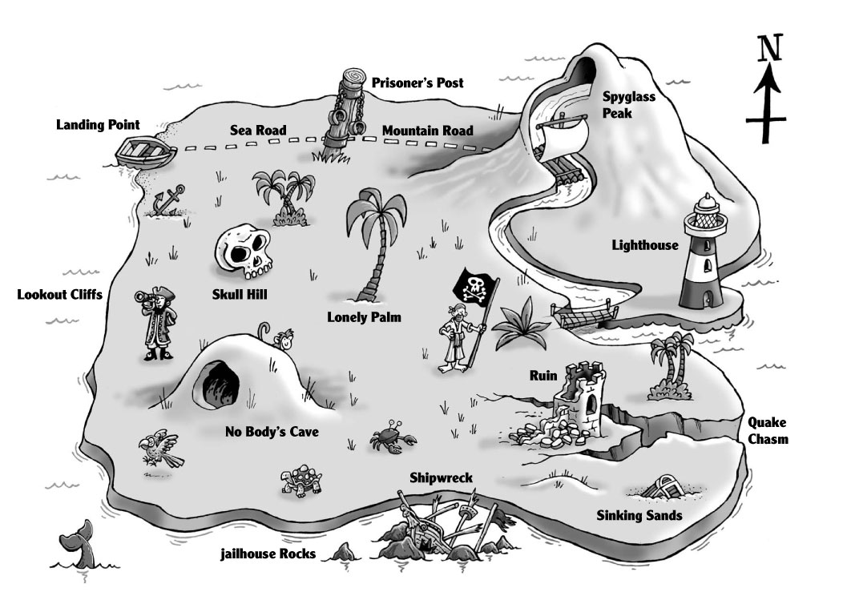
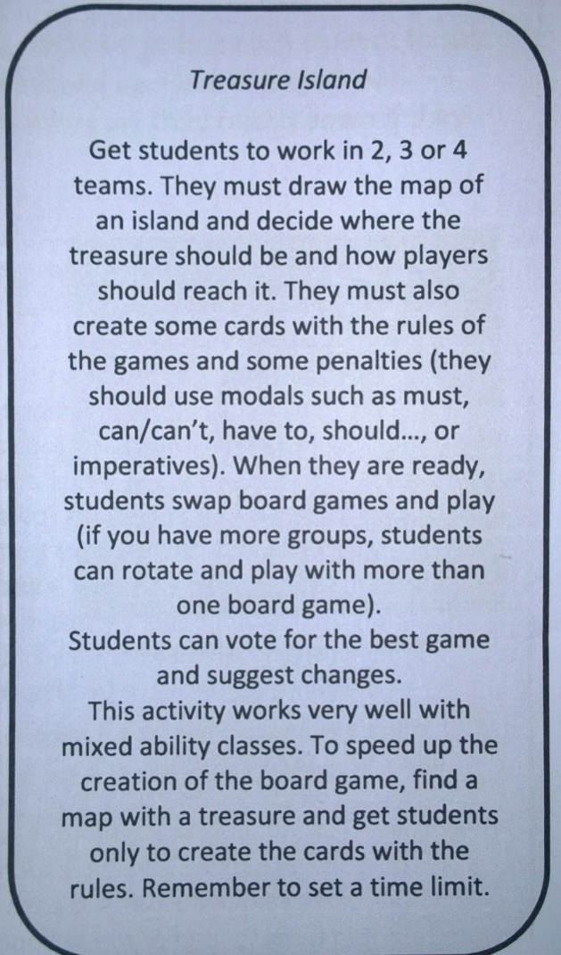
Group work

Slide 8
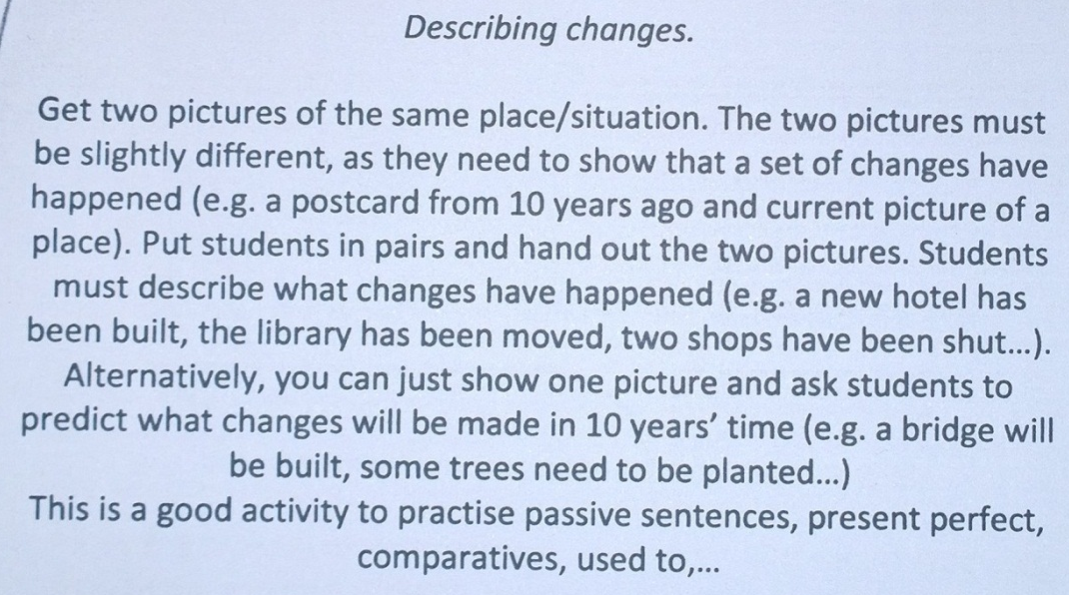
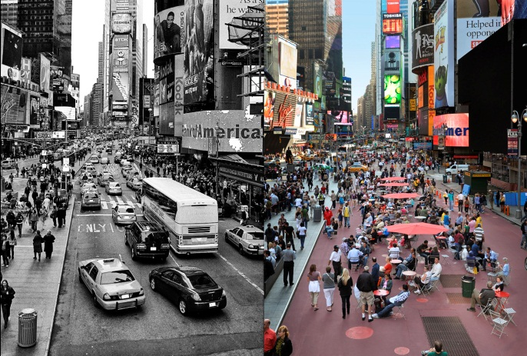
Vocabulary & grammar

Slide 9
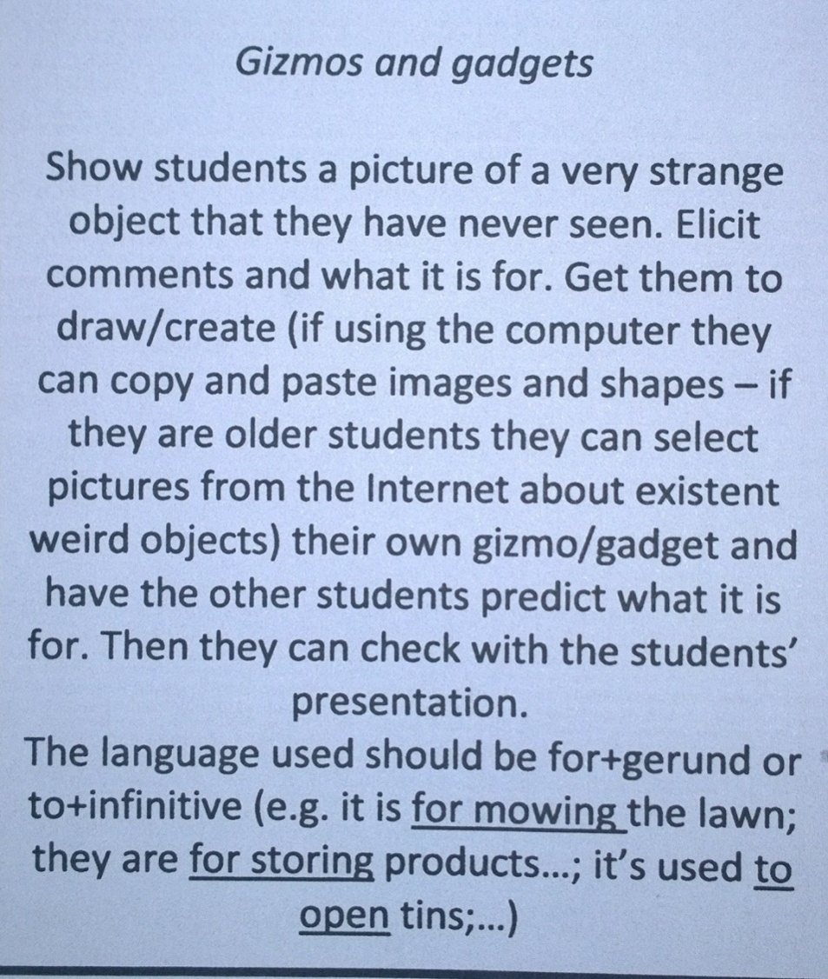
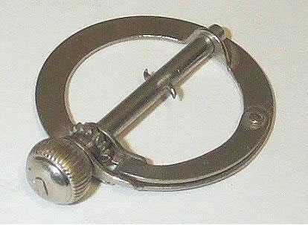
Vocabulary & grammar
Modals…
Have/has…

Slide 10
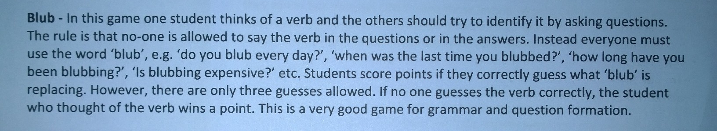
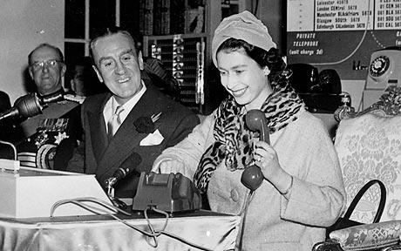
Vocabulary & grammaar

Slide 11
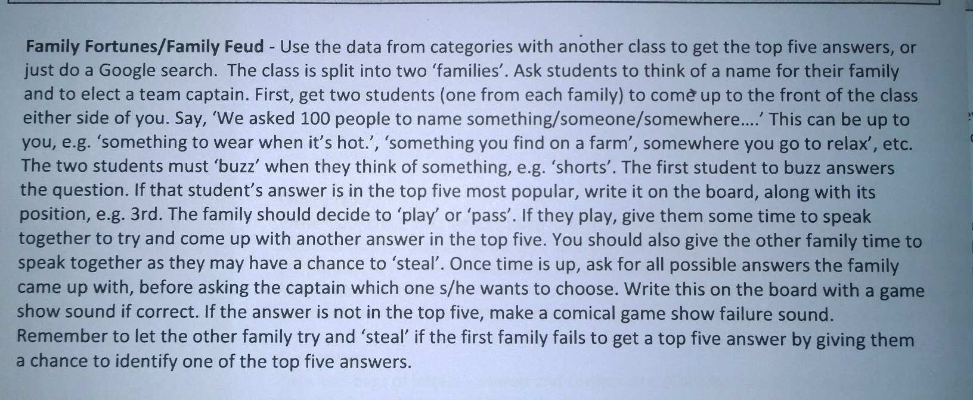
Team work
What do people do in their bathroom?

Slide 12
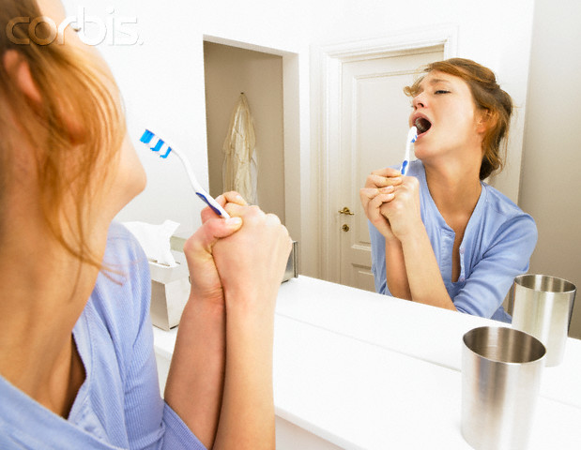
Team work
What do people do in their bathroom?
  74 Take a shower
  55 Use the toilette
  31 Brush their teeth
  21 Sing
  17 Put make-up on

Slide 13
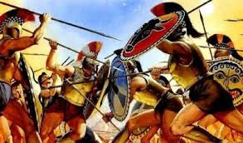
Team work
Kad pomislite na __________________, čega se najčešće sjetite?
Napraviti popis 5 pojmova, a vi napravite svoju listu i proizvoljno dodijelite bodove.
Predmeti, ključni pojmovi:
Biologija: sisavci
(posteljica, tobolčari, jednootvori, prekriveni dlakom, zubalo)
Povijest: Peloponeski rat
(Peloponeski i atenski pomorski savez, Pirej, Potideja, demagozi, vladavina tridesetorice tirana)

Slide 14
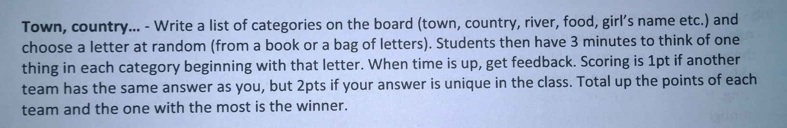
vocabulary
Country | Town/city | Object | Animal | Vegetable | Fruit | Adjective | Verb
Croatia | Capetown | Carpet | Chimpanzee | Cucumber | Cherry | Cheasy | Compete

Slide 15
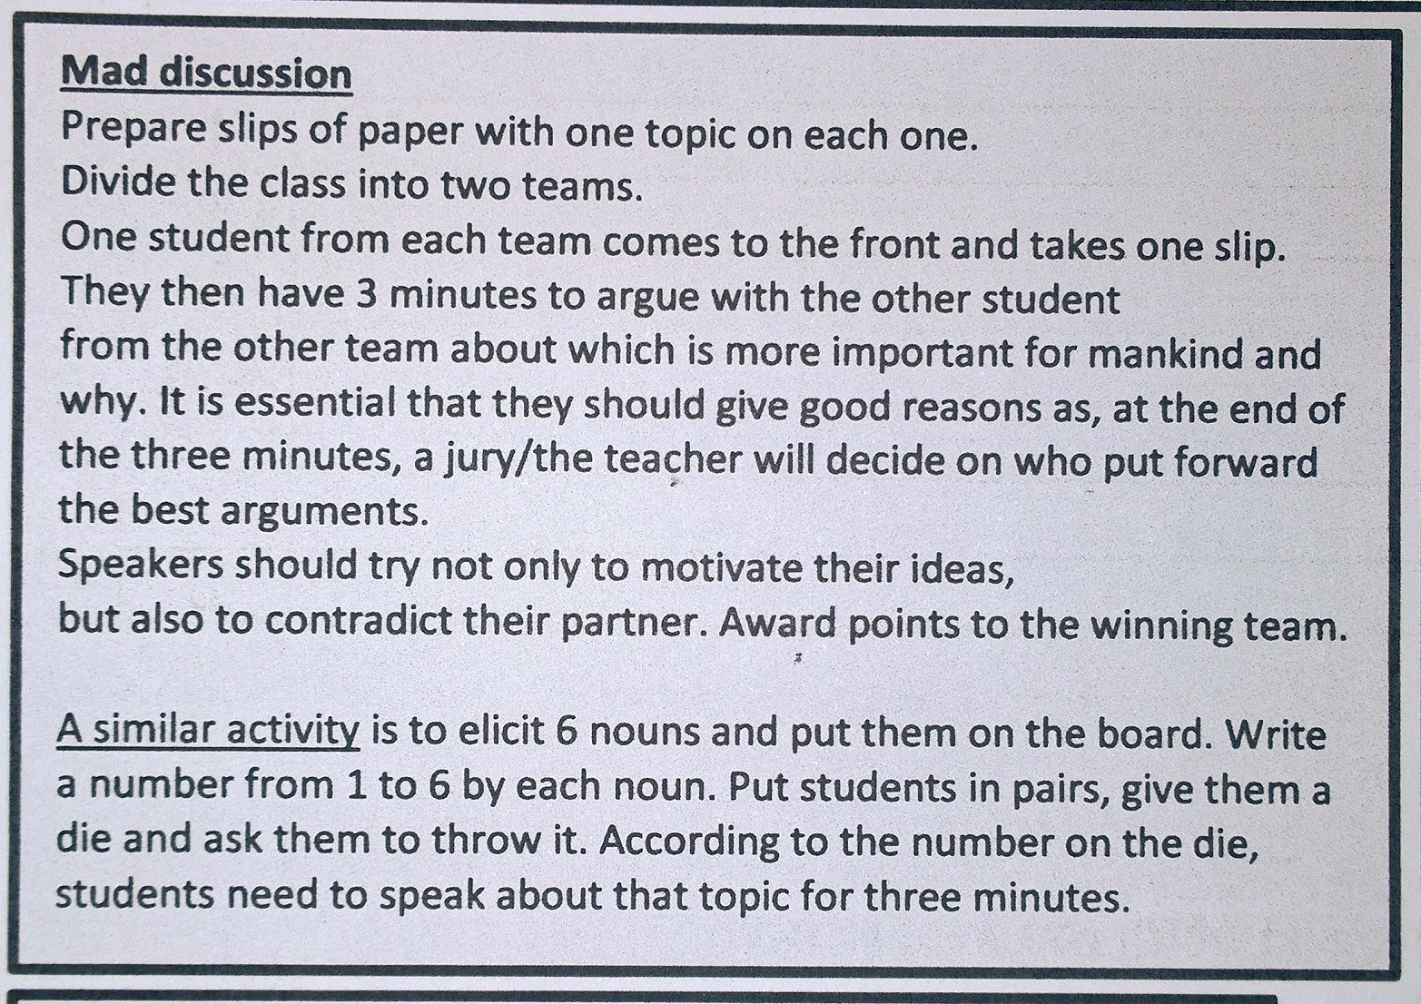
speaking
Having fun Cars Music Love Clothes Weather

Slide 16
Šest tema
Šest tema u šest grupa
(rasprava, bilješke, prikupljanje podataka, pitanja kolegama...)
Primjer: hrvatski jezik
Kraljevo
Baraka Pet Be
Gospoda Glembajevi
Povratak Filipa Latinovicza
Khevenhiller
biografija Krleže
Snijeg
Primjer 2.:
Kaštelan, Parun, Pupačić, Mihalić, Slamnig, Šoljan

Slide 17
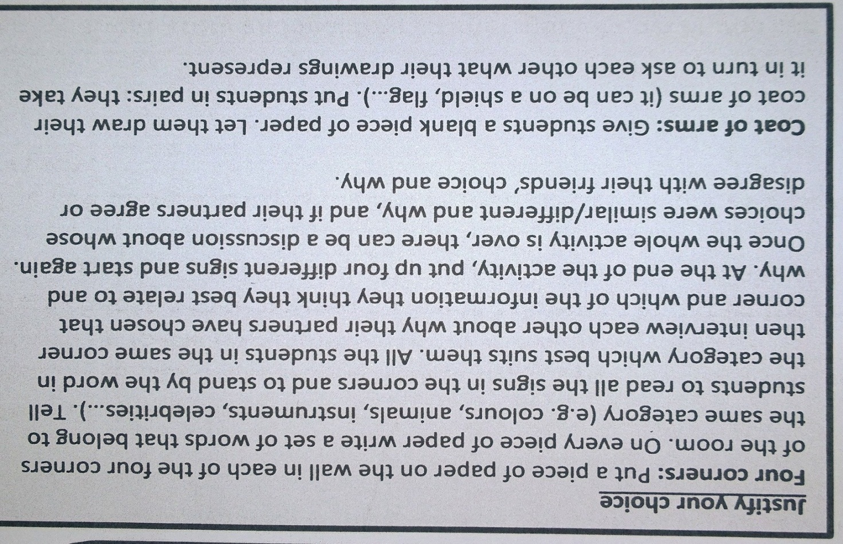
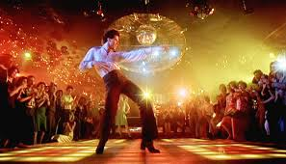
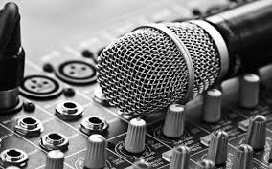
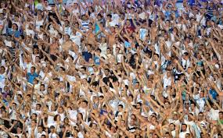
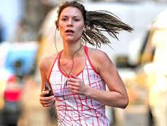
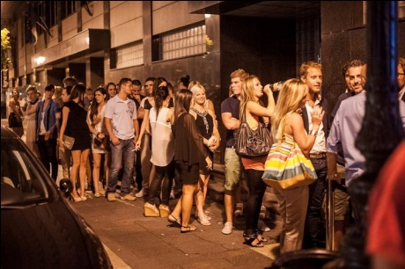
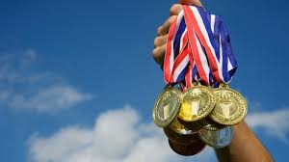
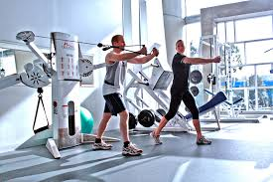
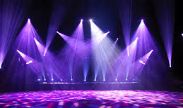
Speaking: JustIFYING YOUR CHOICE

Slide 18
Ols school internet
SIX PAPERS on the walls.
Eg.
Descriptions, 3 people and 3 animals
Culture and civilisation
Print papers with 10, 20 questions or gaps.
Students in groups walk around the classroom and search for answers.
Only one student from the group can be standing at the time.
Teacher prepares at home, students do the work alone.
Primjeri:
Hrvatski jezik: biografije,
Biologija: životinjska vrsta,
Informatika: dijelovi računala,
Filozofija: Bacon, Descartes, Hobbes, Lock, Berkeley, Hume, Spinoza, Leibniz)

Slide 19
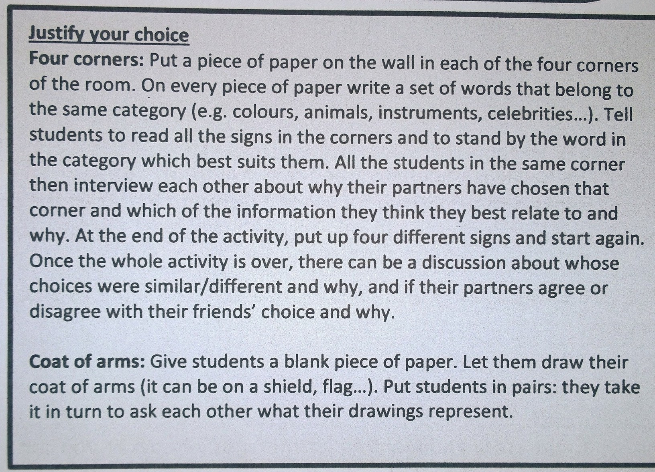


Speaking, WRITING…

Slide 20
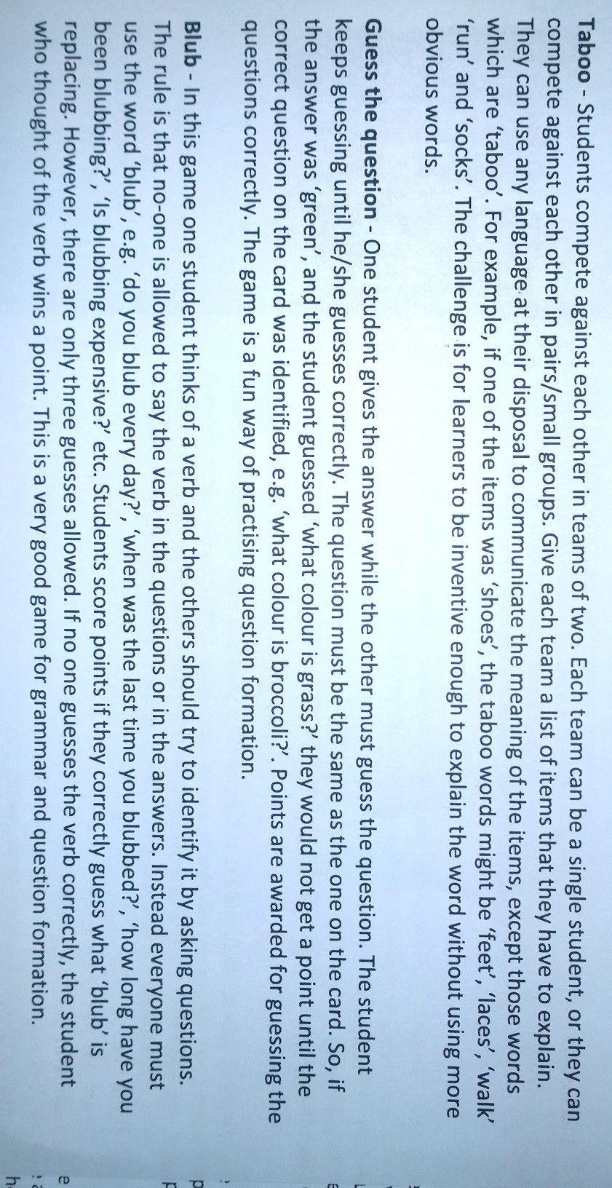
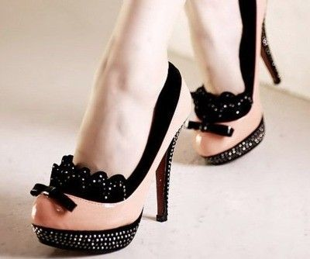
SPEAKING
It’s the thing…

Slide 21
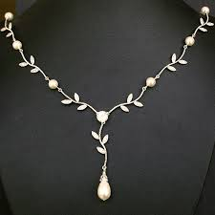
SPEAKING

Slide 22
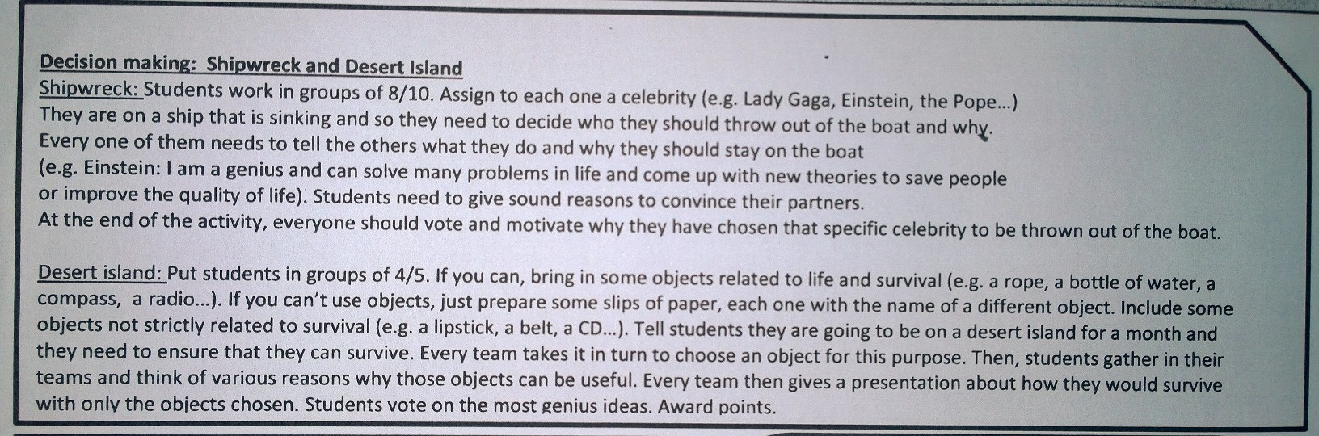
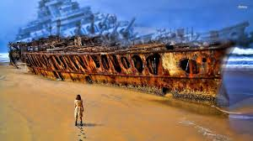
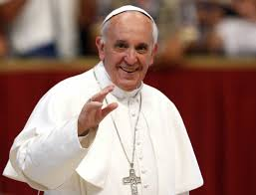
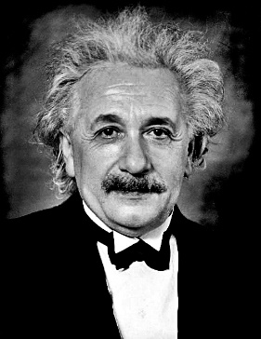
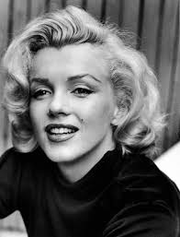
Speaking

Slide 23
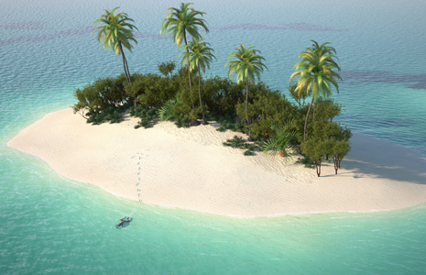
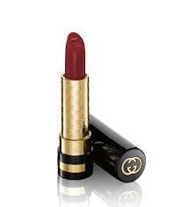
DESERT ISLAND

Slide 24
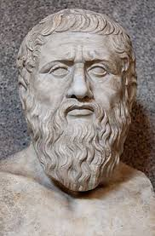
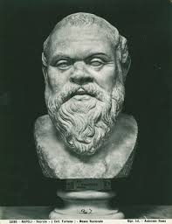
Game of thrones
Two chairs in front of the blackboard or each of the rows.
English:
(un)countable nouns, (ir)regular verbs, tenses, articles...
Povijest: razdoblja
Priroda: godišnja doba
Matematika: parni i neparni
...

Slide 25
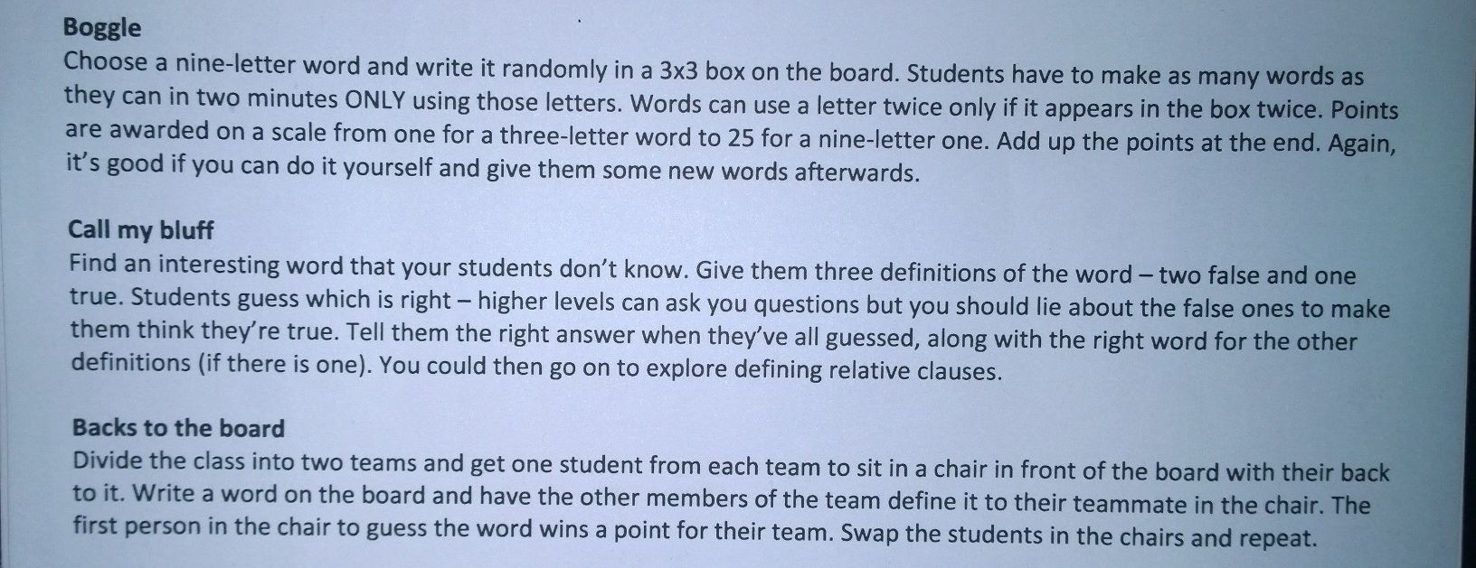
Motivation
A | S | L
I | I | I
T | B | E

Slide 26
ABILITIES
A | S | L
I | I | I
T | B | E

Slide 27
Motivation
H | L | F
L | H | E
S | S | I

Slide 28
SHELLFISH
H | L | F
L | H | E
S | S | I

Slide 29
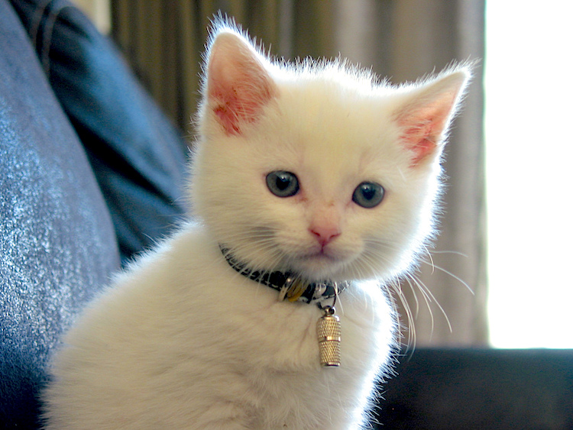
Mnemonics: mIAU
swim – swam – swum
ring – rang – rung
drink – drank – drunk
A cat drinks milk,
has a bell around the neck
and doesn’t like swimming.

Slide 30


Mnemonics: comparison
THE
MOST
MORE
THE
MOST
MORE

Slide 31
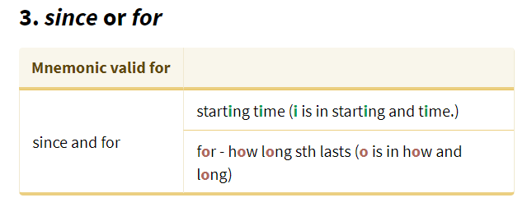
Mnemonics

Slide 32
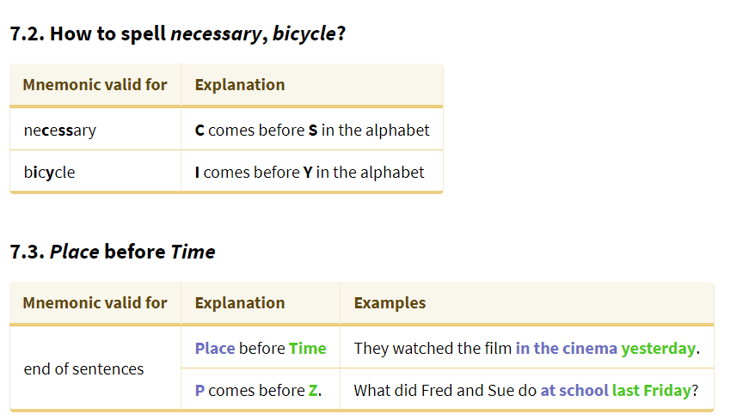
Mnemonics

Slide 33
Mnemonics

Slide 34
Mnemonics

Slide 35
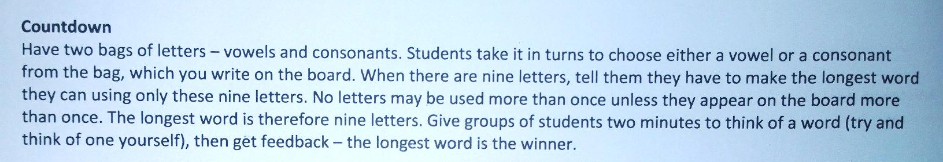
Words, words…

Slide 36
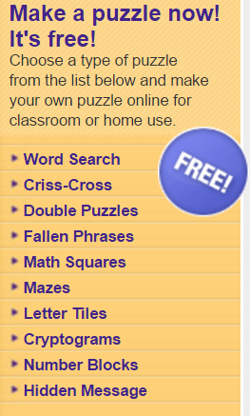
Online resources
Puzzles
Word search
Criss-cross
Double puzzles
Math squares
Mazes
Letter tiles
...
Quick, efficient, great as test, practice, revisions...
Eg.
Capital of UK: _________________________
Flower of England: ________________________
http://www.discoveryeducation.com/free-puzzlemaker/?CFID=341245&CFTOKEN=29d8c15248b4db37-1170D2E0-097E-9CE0-D9631C7FCBFFF9EC

Slide 37
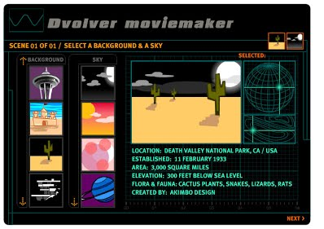
moviemaker
Converation, two characters
Fairytales
Mum and son
Father and daughter
Two friends
Deciding on a holiday...
Meeting new people
Super fast and super simple
www.dvolvermovie.com

Slide 38
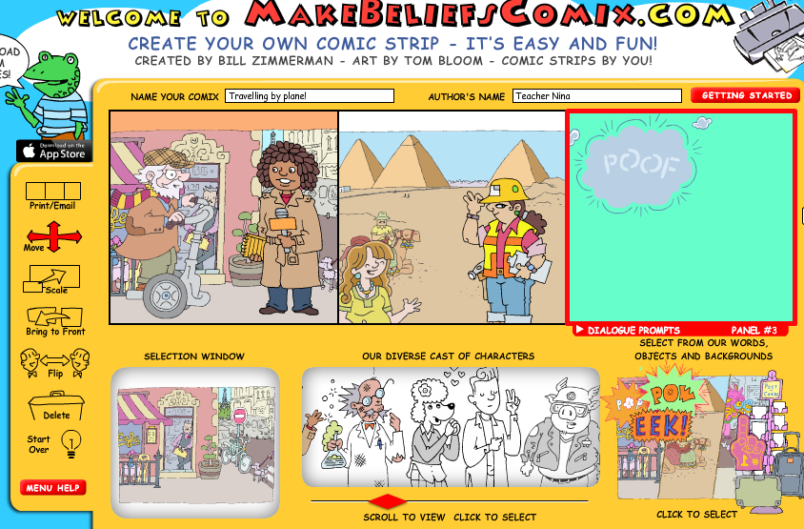
Comics
Makebeliefcomix
Wittycomix

Slide 39
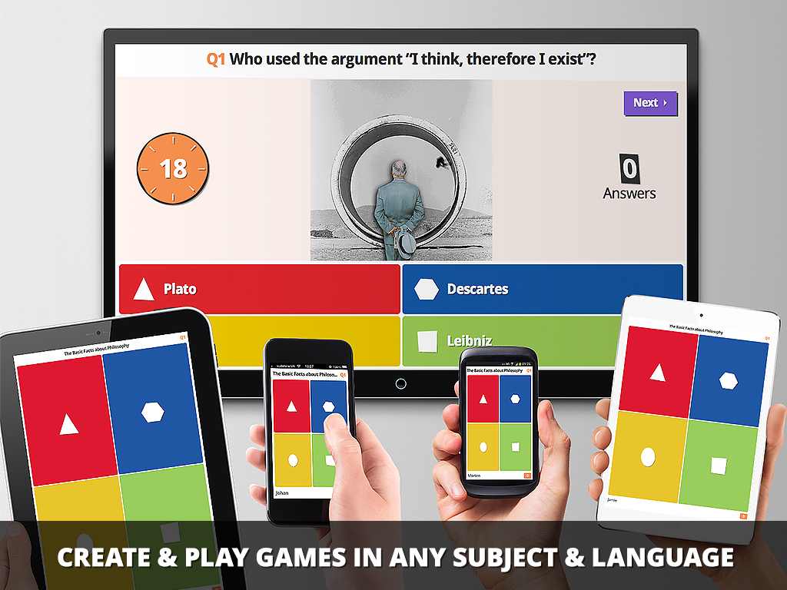
kahoot.it
Quiz + smartphones
Answers: photos, video clips, words, sentences, sounds
Awaard different number of points
Time for answering
My students’ EX favourite!

Slide 40


  anitakuduz@gmail.com
  Prva riječka hrvatska gimnazija
  Trust yourselves!
  Thank you!

Slide 41

Thank you!
Anita Jokić, prof.
Prva riječka hrvatska gimnazija
anitakuduz@gmail.com

