Slide 1
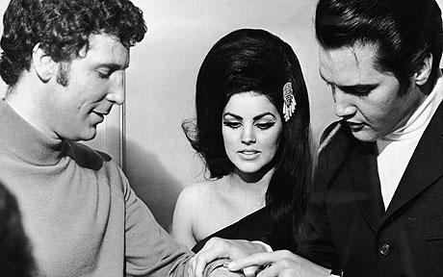
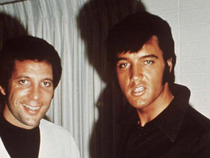
Story of a friendship: Elvis Presley and Tom Jones APPI conference, Aveiro 2018
Anita Jokić, prof.
Prva riječka hrvatska gimnazija, Rijeka

Slide 2
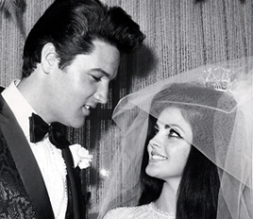
Class project, 4 lessons
Lesson 1:
listening to song clips, guess the titles and artists
think of your best friend, write down a song title
discussion, what do you know about them
‘’old school Internet’’ (one student from each group is searching)

Slide 3
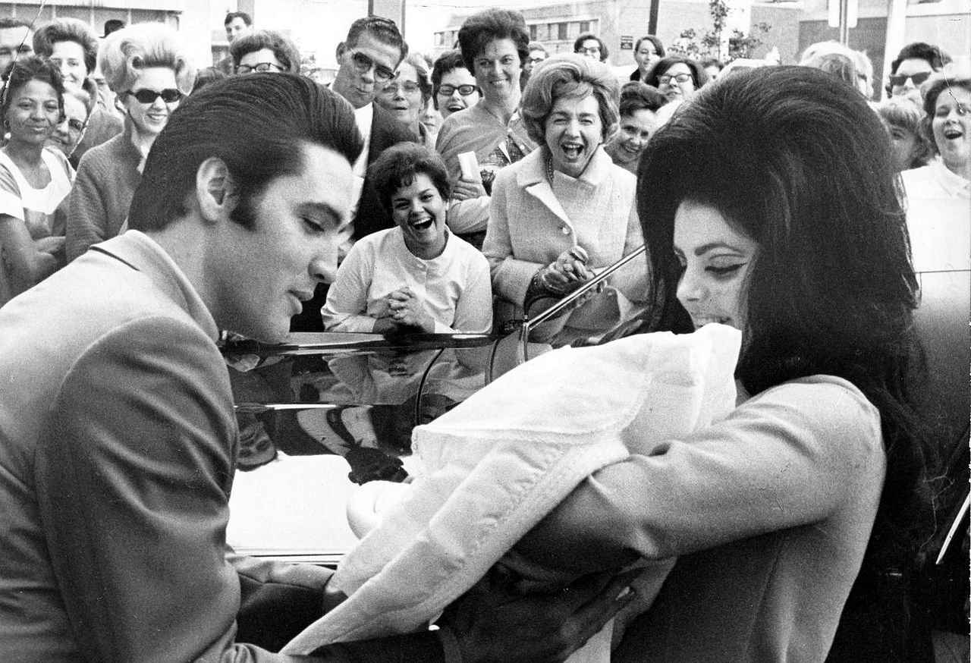
Class project, 4 lessons
Lesson 2:
go through the information found on ‘old school internet’’
add extra information
discussion, what more do you know about them?
what is important for frienship?
what could Tom and Elvis have in common?
video clip: Tom & The Voice, Tom talks about meeting Elvis

Slide 4
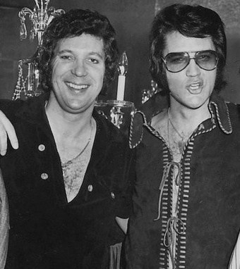
Class project, 4 lessons
Lesson 3:
Acting: How the Legends Met
Humour
Elvis talks about Tom and Tom talks about Elvis
Great songs for discussions:
In the Ghetto (poverty, chances for success)
Delilah (love, cheating)
Suspicious Minds (love, trust and cheating)
She’s a Lady (feminism, male vs. Female)
Always on my Mind (love, forgiveness)

Slide 5
In the ghetto
Then one night in desperation A young man breaks away He buys a gun, steals a car Tries to run, but he don't get far And his mama cries
As a crowd gathers 'round an angry young man Face down on the street with a gun in his hand In the ghetto (in the ghetto)

Slide 6
Delilah
I could see that girl was no good for me But I was lost like a slave that no man could free At break of day when that man drove away, I was waiting I cross the street to her house and she opened the door She stood there laughing I felt the knife in my hand and she laughed no more My, my, my Delilah Why, why, why Delilah

Slide 7
Suspicious minds
We can't go on together With suspicious minds (suspicious minds) And we can't build our dreams On suspicious minds
So, if an old friend I know Stops by to say hello Would I still see suspicion in your eyes?

Slide 8
She’s a lady
Well, she's all you'd ever want She's the kind I like to flaunt and take to dinner But she always knows her place She's got style, she's got grace, she's a winner She's a lady

Slide 9
Always on my mind
Maybe I didn't treat you Quite as good as I should have Maybe I didn't love you Quite as often as I could have Little things I should have said and done I just never took the time
You were always on my mind
Tell me, tell me that your sweet love hasn't died Give me, give me one more chance To keep you satisfied, satisfied

Slide 10
Canva

Slide 11
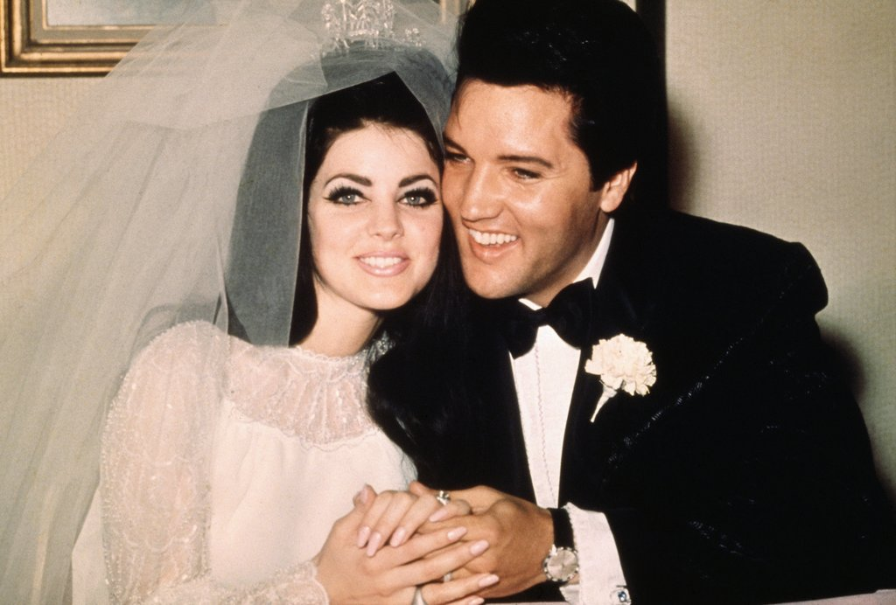
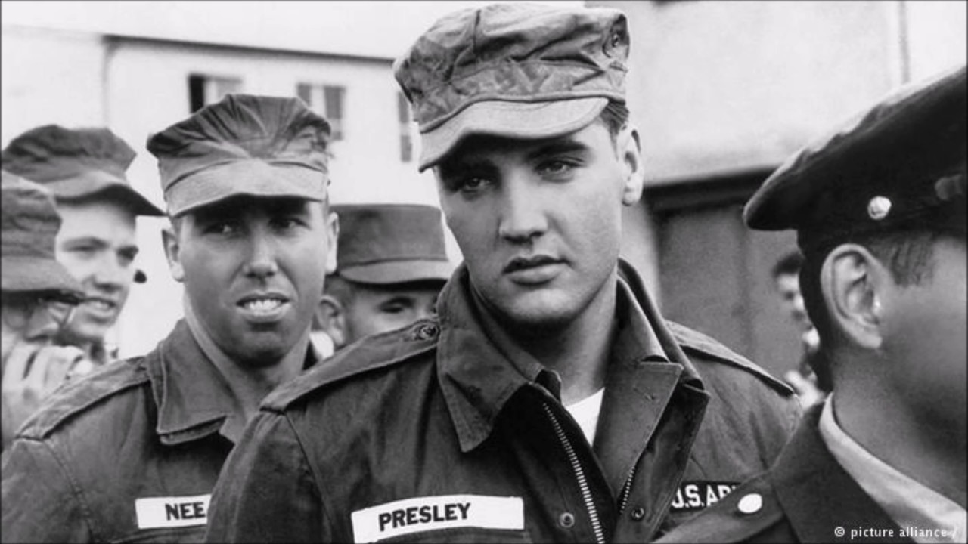
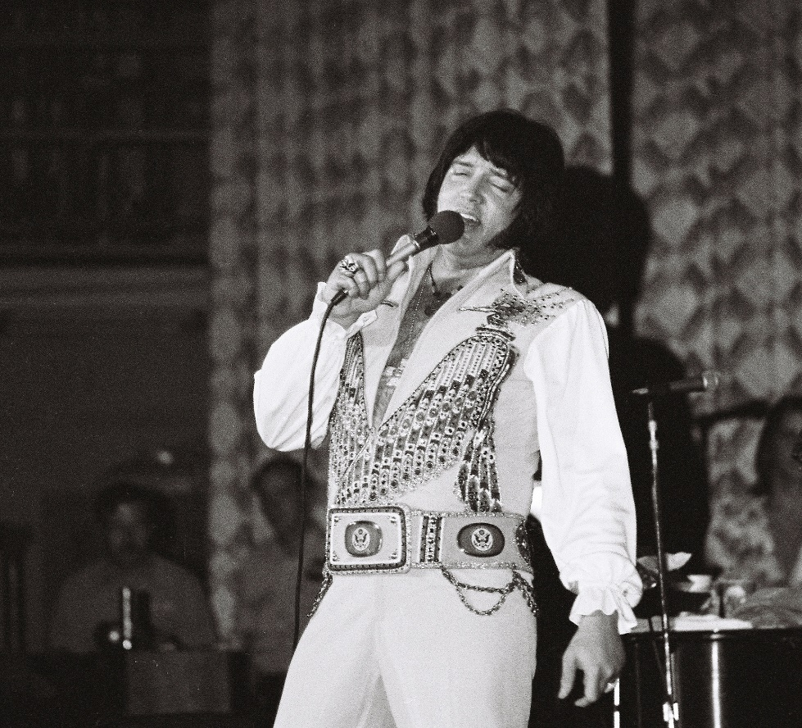
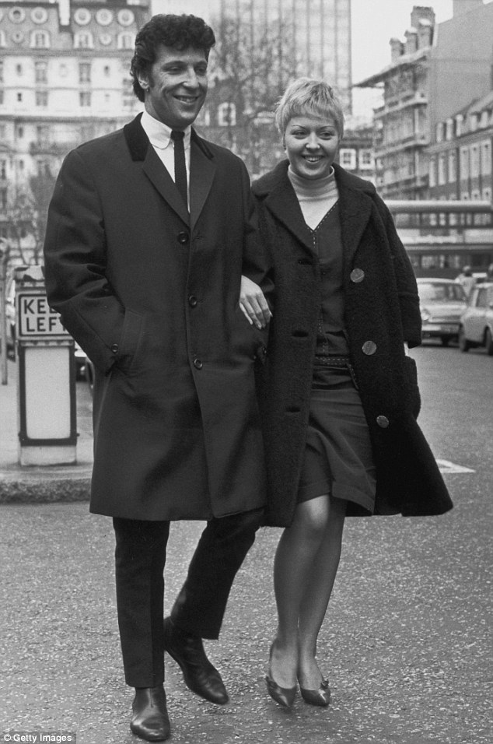
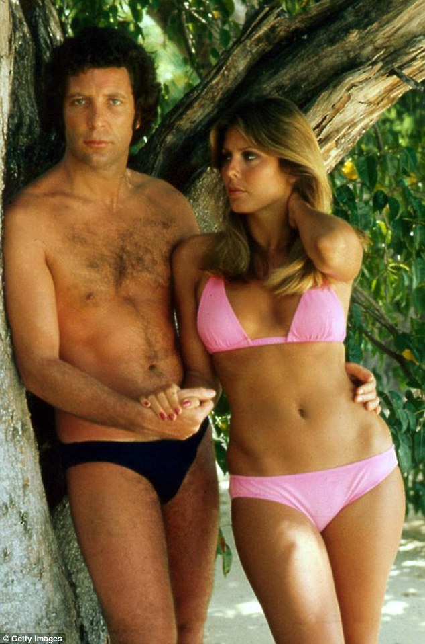
Class project, 4 lessons
Lesson 4:
Newspaper covers (old-school or Canva or Padlet)
Quiz: Kahoot or Triventy
Tom misses Elvis > song: Elvis Presley Blues

Slide 12
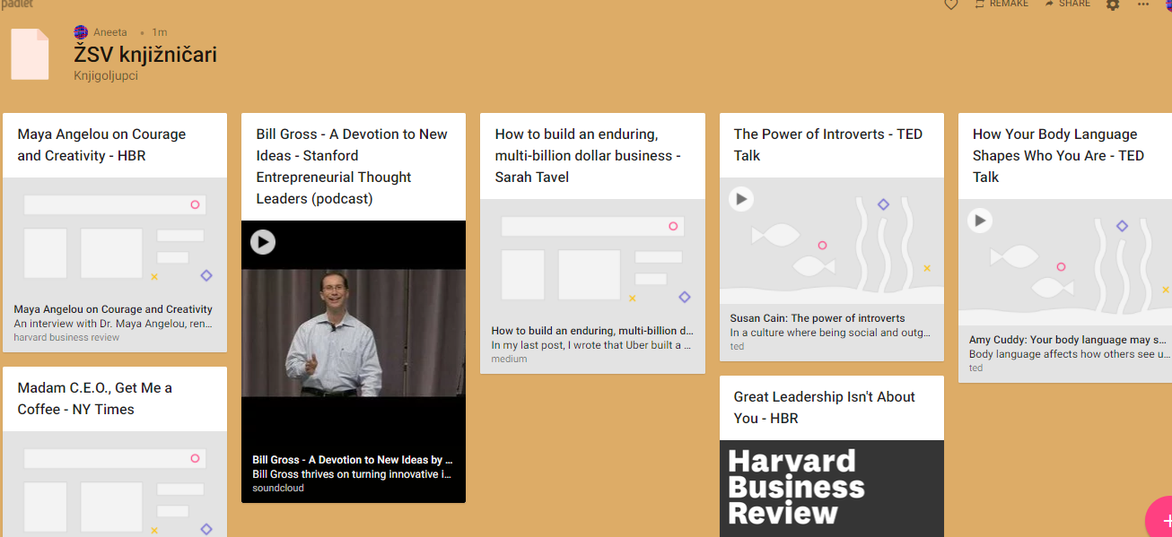
Padlet

Slide 13
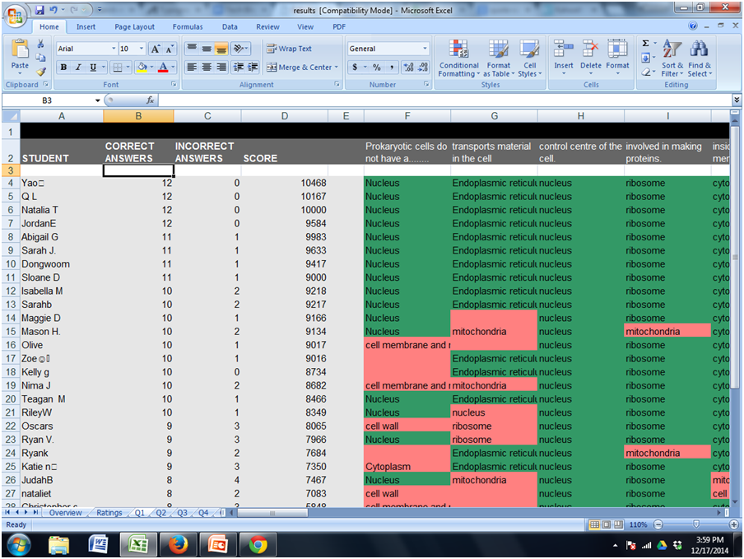
Kahoot

Slide 14
Triventy

Slide 15
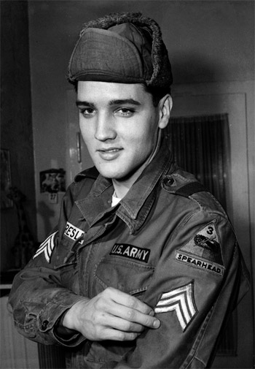
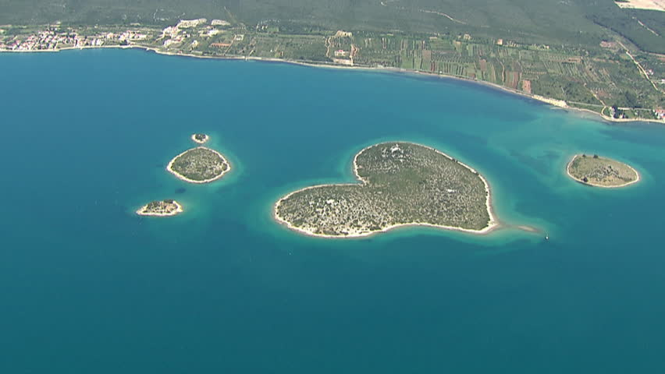
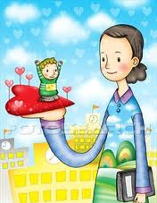
The best teachers teach from the heart,
not from the book.
Ps.
Even islands have hearts in Croatia.
So visit us in April 2019 at HUPE conference by the sea in Poreč.
Thank you!

Slide 16
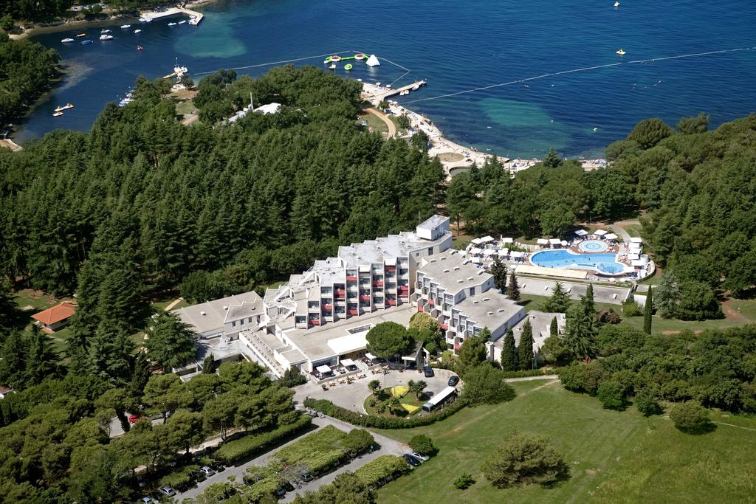
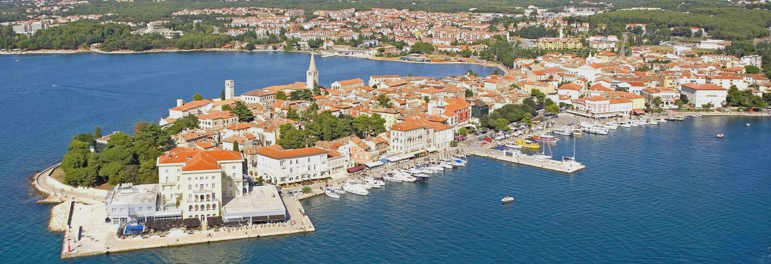
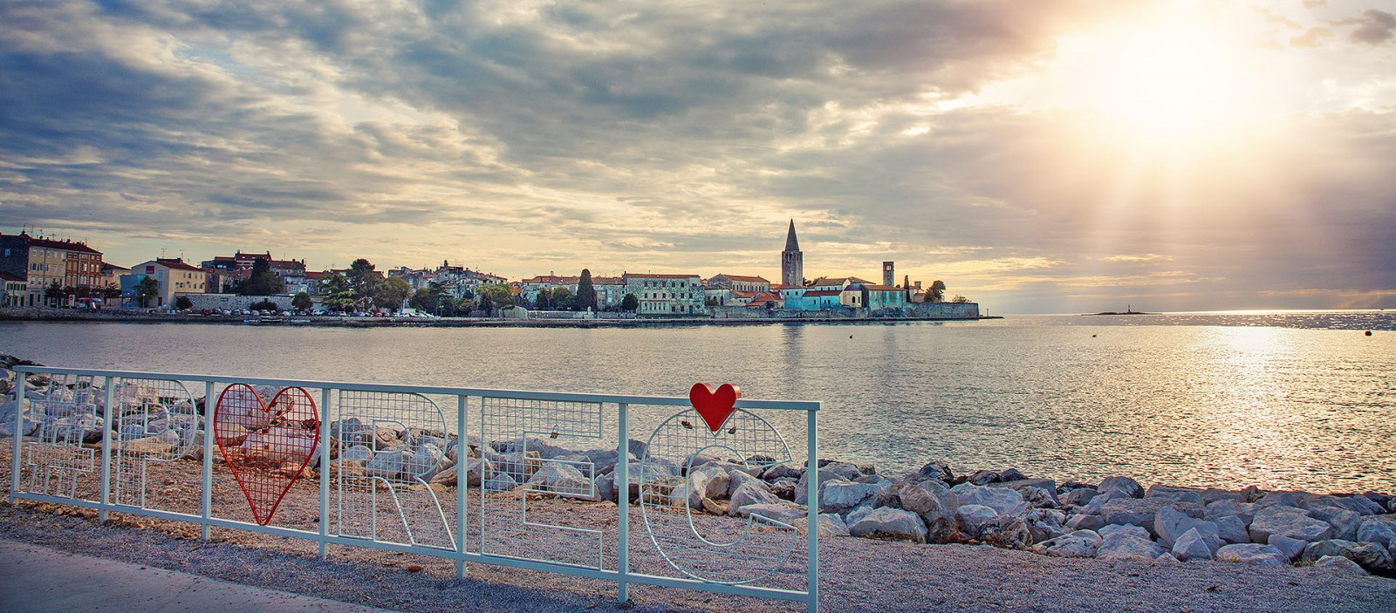
Anita Jokić
anitakuduz@gmail.com
google: ZSV Anita

