Slide 1
Power of Women IATEFL Slovenia
Anita Jokić, prof.
Prva riječka hrvatska gimnazija / Maritime University Rijeka, Rijeka, Croatia

Slide 2
Some made music, some made noise, all made a difference.

Slide 3
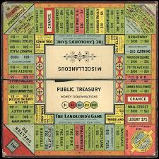
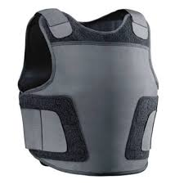
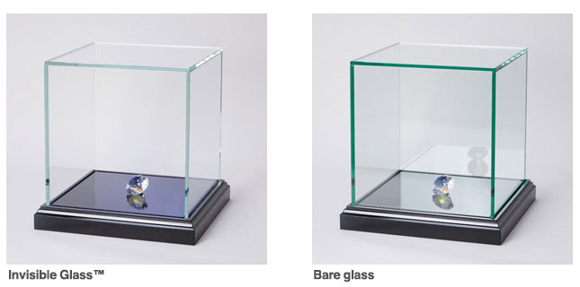
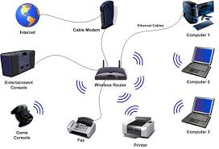
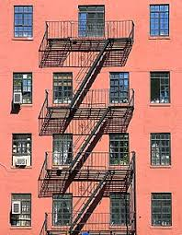
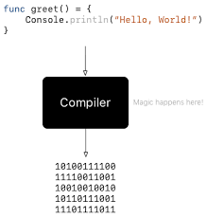
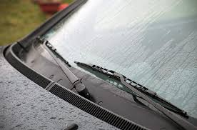
What are these objects? What do they have in common?

Slide 4
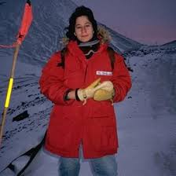
Class project, 4 lessons
Aims:
think about the role and position of women in society throughout history
Practice cooperation and team work
Write a speech
Create a newspaper cover
Creatively implement what you have learned

Slide 5
Lesson 1: What are these objects? What do they have in common?

Slide 6
Video…
https://www.youtube.com/watch?v=rPDf9H-8bRc
Inventions that changed history
Gap filling, checking

Slide 7
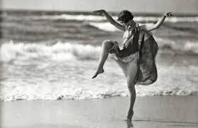
Lesson 2: Cards
Guess the name or accomplishment of women in the photos
Turn the card when you do not know the answer, read the name, make guesses
Read the whole text on the back of the card
Make three piles:
Women you recgnized by photo
Women you recognized by decription
Women you have never heard of
Choose three you think your class should know about

Slide 8
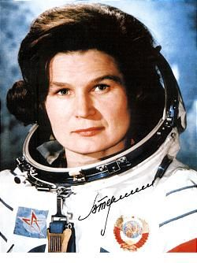
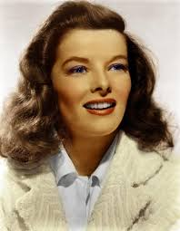
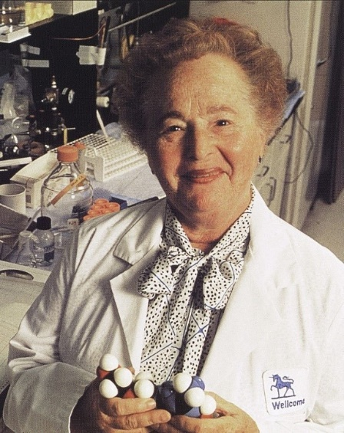
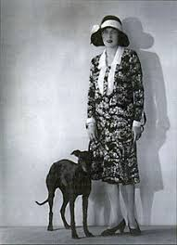
Do you want to add any names?
Sports
Politics, historical figures
Arts, films, music
Science
other…

Slide 9
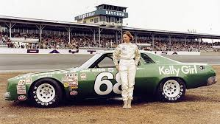
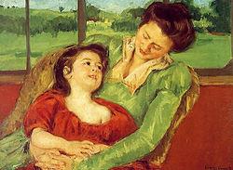
Video 2
https://www.youtube.com/watch?v=7SSNzSx5yk0
14 Women who changed the history
Guess who they are… before you watch
Make a list of 5 you expect to be in the video

Slide 10
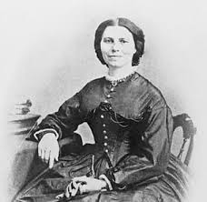
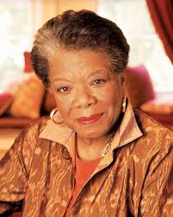
Lesson 3: Speech and song
Students write a speech from the perspective of a women whey have chosen

Slide 11
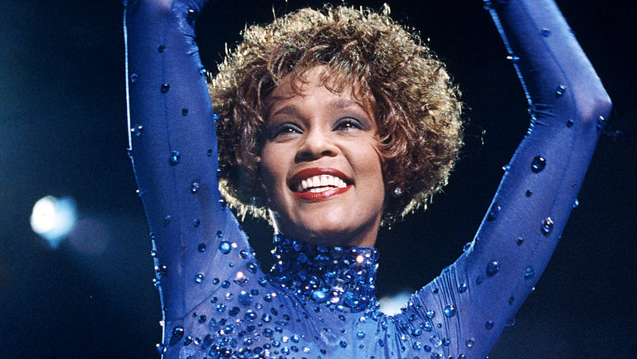
Song: Whitney Houston: One moment in time

Slide 12
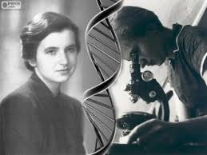
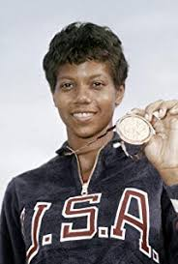
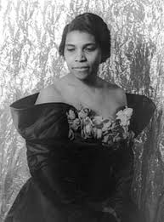
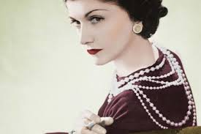
Song extra: diary entry
You have just arrived home from an Awards Ceremony, you have won and people have recognized your effort and knowledge
Use vocabulary you’ve written down in song gaps:
Best
Unknown
Dreams….

Slide 13
Lesson 4: Newspaper covers and exhibiton

Slide 14
Thank you!
anitakuduz@gmail.com
All materials and links can be found @Google:
Anita Jokić ŽSV

